Slide 1
Deep Learning
Generated for: CNNs, Convolution Operation, Pooling Layers, CNN Architecture Example, Applications of CNNs
Notes:
Welcome to the Deep Learning presentation covering multiple topics. Today we'll explore: CNNs, Convolution Operation, Pooling Layers, CNN Architecture Example, Applications of CNNs.

Slide 2
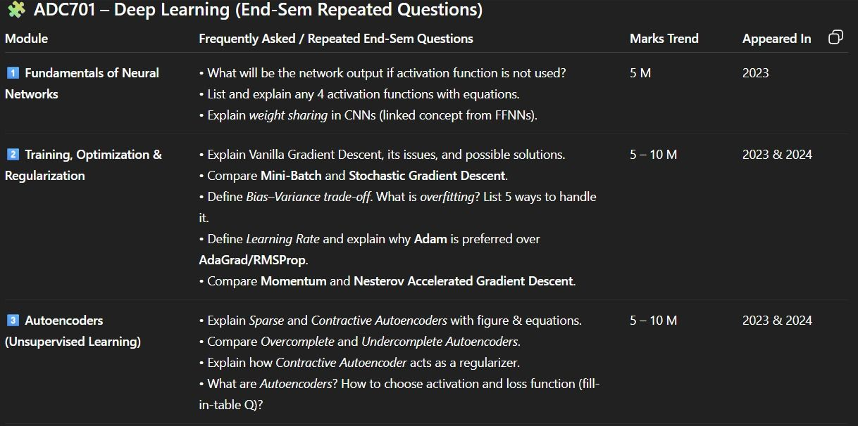
CNNs - Introduction
Convolutional Neural Networks extract features from images
Inspired by biological neural networks and visual cortex
Use convolutional and pooling layers for feature extraction
Apply convolutional layers for image classification tasks
Pooling layers reduce spatial dimensions and retain features
Fully connected layers used for final classification output
CNNs trained using backpropagation and stochastic gradient
Regularization techniques prevent overfitting in CNNs
Activation functions like ReLU used for non-linearity introduction
Notes:
When introducing CNNs, explain the biological inspiration behind their design and how they are particularly suited for image classification tasks. Provide examples of applications such as self-driving cars and facial recognition systems. Emphasize the role of convolutional and pooling layers in feature extraction and dimensionality reduction. Discuss the importance of regularization techniques and the use of activation functions like ReLU. Ask students to consider how CNNs can be applied to real-world problems and what advantages they offer over traditional neural networks.

Slide 3
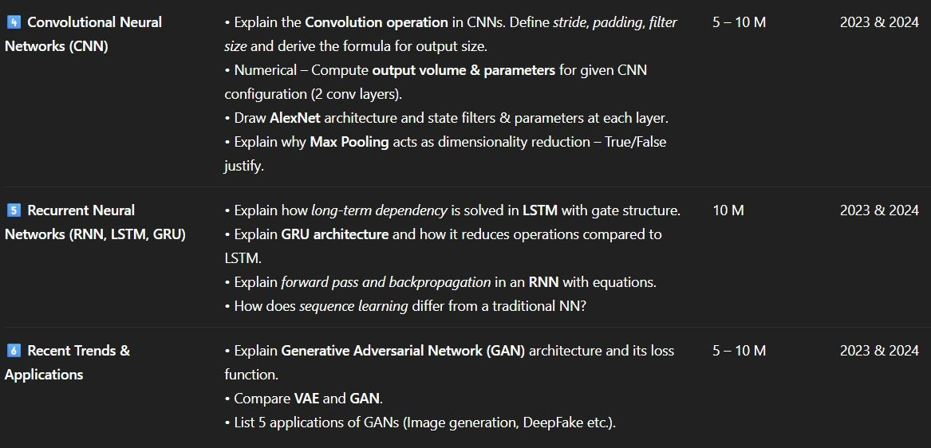
CNNs - Introduction
Convolutional Neural Networks process data with grid-like topology
Inspired by biological neural networks and visual cortex
Use convolutional and pooling layers for feature extraction
Key application areas include image classification and object detection
Effective in image processing, computer vision tasks
Can learn spatial hierarchies of features from images
Typically consist of convolution, activation, pooling layers
Training involves optimizing weights, biases for accuracy
Backpropagation used for training CNN models efficiently
Activation functions like ReLU introduce non-linearity
Notes:
When introducing CNNs, emphasize their ability to automatically and adaptively learn spatial hierarchies of features from images. Explain how the convolutional and pooling layers work together to achieve this. Provide examples of applications such as self-driving cars using CNNs for object detection and image classification. Ask students to consider how the architecture of a CNN allows it to learn complex patterns in data. Discuss the importance of activation functions and backpropagation in the training process. Key takeaways should include understanding the basic components of a CNN and their roles in image processing tasks.

Slide 4

CNNs - Architecture
Convolutional Neural Networks use convolutional layers
Convolutional layers extract local features from data
Pooling layers reduce spatial dimensions of data
Fully connected layers classify extracted features
Activation functions introduce non-linearity to models
ReLU is a commonly used activation function
Batch normalization improves model training speed
Dropout prevents overfitting in deep neural networks
y = σ(Wx + b) is a basic neural network equation
Notes:
When explaining the architecture of CNNs, emphasize the role of each layer type, such as convolutional layers for feature extraction and pooling layers for dimensionality reduction. Provide examples of how these layers work together to classify images. Ask students to consider how the choice of activation function or regularization technique can impact model performance. Key takeaways include understanding the basic components of a CNN and how they contribute to its ability to learn complex patterns in data.

Slide 5
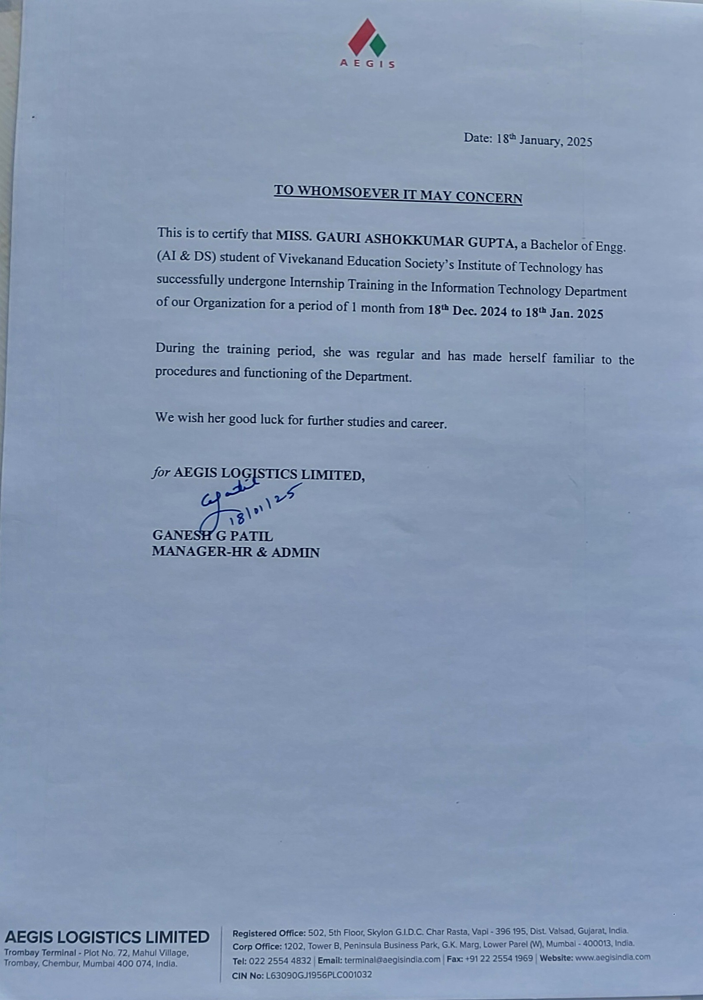
Convolution Operation - Introduction
Convolution operation is a fundamental concept in deep learning
Used for image and signal processing tasks
Involves sliding filters over input data
Filters learn to detect specific patterns and features
Convolutional neural networks (CNNs) utilize this operation
CNNs are widely used in computer vision applications
Image classification and object detection are key applications
Convolution operation reduces spatial dimensions
Helps in extracting local and global features
Notes:
When introducing the convolution operation, explain its significance in deep learning and its applications in image and signal processing. Provide examples of how CNNs use convolution to detect patterns and features in images. Ask students to consider how the convolution operation reduces spatial dimensions and helps in feature extraction. Key takeaways should include understanding the basics of convolution and its role in CNNs. You can also give examples of real-world applications, such as self-driving cars and facial recognition systems, to illustrate the importance of convolution operation in deep learning.

Slide 6
Convolution Operation - Introduction
Convolution operation combines images with filters
Applies filters to small regions of image
Produces feature maps with spatial hierarchy
Key component of convolutional neural networks
Used for image classification and object detection
Filters learn to detect edges and patterns
Stride and padding control convolution operation
Activation functions introduce non-linearity
Pooling layers reduce spatial dimensions
y = σ(w*x + b) simple neural network equation
Notes:
When introducing the convolution operation, explain its role in deep learning and how it's used in convolutional neural networks. Provide examples of image classification and object detection tasks. Emphasize the importance of filters and how they learn to detect edges and patterns. Discuss the concepts of stride, padding, and activation functions, and how they contribute to the overall convolution operation. Use the simple neural network equation as a reference point to illustrate the introduction of non-linearity. Ask students to consider how the convolution operation enables the network to learn hierarchical representations of images. Key takeaways include understanding the convolution operation, its components, and its applications in deep learning.

Slide 7
Convolution Operation - Introduction
Convolution operation combines images with filters
Extracts features from small image regions
Typically used in image classification tasks
Filters scan images horizontally and vertically
Feature maps are generated from filter outputs
Convolution preserves spatial relationships
Stride and padding affect output dimensions
Conv2D layers used in neural network architectures
y = σ(w*x + b) simple neural network equation
Convolutional neural networks learn features
Notes:
When introducing the convolution operation, explain how it's a fundamental component of convolutional neural networks. Provide examples of image classification tasks, such as recognizing objects in images. Emphasize how convolution preserves spatial relationships and how filters are used to extract features. Use simple equations like y = σ(w*x + b) to illustrate basic neural network concepts. Ask students to consider how stride and padding affect output dimensions and how this impacts network performance. Key takeaways include understanding the role of convolution in image processing and its application in deep learning architectures.

Slide 8
Pooling Layers - Introduction
Pooling layers reduce spatial dimensions of data
Downsampling technique for feature maps
Helps prevent overfitting in deep networks
Reduces number of parameters and computations
Max pooling is most commonly used variant
Average pooling is another type of pooling
Pooling layers are used in convolutional networks
Improves translation invariance of features
Enhances robustness to small transformations
Simplifies the architecture of deep models
Notes:
When introducing pooling layers, explain that they are a crucial component in deep learning, particularly in convolutional neural networks. Provide examples of how max pooling and average pooling work, and ask students to consider the benefits of using pooling layers, such as reduced overfitting and improved translation invariance. Key takeaways include understanding the purpose of pooling layers, their types, and their applications in deep learning architectures.

Slide 9
Pooling Layers - Introduction
Reduce spatial dimensions of data with pooling layers
Downsample feature maps to reduce parameters
Helps prevent overfitting in deep neural networks
Max pooling and average pooling are common types
Used in convolutional neural networks (CNNs)
Improves translation invariance of features
Reduces computational cost of subsequent layers
Increases robustness to small transformations
Commonly used in image and signal processing
Enhances model performance on limited data
Notes:
When introducing pooling layers, explain that they are a crucial component in deep learning, particularly in CNNs. Emphasize how they help in reducing the spatial dimensions of the data, which in turn reduces the number of parameters and the risk of overfitting. Provide examples of max pooling and average pooling, and explain how they differ. Discuss the benefits of using pooling layers, such as improved translation invariance and reduced computational cost. Ask students to consider how pooling layers might be applied to real-world image or signal processing tasks, and what the potential drawbacks might be. Key takeaways should include the types of pooling layers, their benefits, and common applications.

Slide 10
Pooling Layers - Introduction
Reducing spatial dimensions of feature maps
Downsampling technique for data reduction
Helps prevent overfitting in deep networks
Pooling layers follow convolutional layers
Max pooling is most commonly used
Average pooling also used in some cases
Pooling layer reduces number of parameters
Improves robustness to small transformations
Enhances translational invariance property
Simplifies computation and memory usage
Notes:
When introducing pooling layers, explain that they reduce the spatial dimensions of feature maps, which helps prevent overfitting. Provide examples of max and average pooling, and ask students to consider the benefits of downsampling, such as reduced parameters and improved translational invariance. Key takeaways include understanding the purpose of pooling layers and their common types, as well as their impact on deep network performance.

Slide 11
CNN Architecture Example - Introduction
Convolutional Neural Networks (CNNs) for image classification
Utilize convolutional and pooling layers for feature extraction
LeNet-5 and AlexNet as pioneering CNN architectures
CNNs applied in self-driving cars and facial recognition
Image processing and computer vision tasks
Learning spatial hierarchies of features
Local connectivity and shared weights
Reducing parameters with pooling layers
Improving performance with deeper networks
Example: CIFAR-10 dataset for image classification
Notes:
When introducing the CNN architecture example, explain the basics of convolutional neural networks and their applications in image classification. Provide examples of pioneering architectures like LeNet-5 and AlexNet. Emphasize the importance of convolutional and pooling layers in feature extraction. Ask students to consider how CNNs can be applied in real-world tasks such as self-driving cars and facial recognition. Key takeaways include understanding local connectivity, shared weights, and the role of pooling layers in reducing parameters. Use the CIFAR-10 dataset as a concrete example for image classification tasks.

Slide 12
CNN Architecture Example - Introduction
Convolutional Neural Networks process data with grid-like topology
Inspired by biological neural networks and visual cortex
Typical applications include image classification and object detection
CNNs consist of convolutional and pooling layers
Activation functions introduce non-linearity to the model
ReLU is a commonly used activation function
CNNs can learn spatial hierarchies of features
LeNet-5 is an early example of a CNN architecture
Modern CNNs include ResNet and Inception models
Notes:
When introducing the CNN architecture example, explain the inspiration behind CNNs and their typical applications. Emphasize the importance of convolutional and pooling layers, and how activation functions like ReLU introduce non-linearity. Provide examples of early CNN models like LeNet-5 and modern models like ResNet and Inception. Ask students to consider how CNNs can learn spatial hierarchies of features and how this applies to image classification and object detection tasks. Key takeaways include understanding the basic components of a CNN and their applications in deep learning.

Slide 13
CNN Architecture Example - Introduction
Convolutional Neural Networks (CNNs) for image classification
CNNs consist of convolutional and pooling layers
Activation functions like ReLU used for feature extraction
Flatten layer used to transform data for dense layers
Dense layers for classification and regression tasks
CNN architecture inspired by human visual cortex
Weight sharing reduces number of trainable parameters
Local connectivity for spatial hierarchies of features
y = σ(Wx + b) for neural network computation
Notes:
Introduce the concept of CNN architecture, explaining each layer's role. Discuss how CNNs are inspired by the human visual cortex and how weight sharing and local connectivity contribute to their effectiveness. Provide examples of CNN applications, such as image classification and object detection. Ask students to consider the benefits and limitations of using CNNs for different tasks. Key takeaways include understanding the basic components of a CNN and their functions, as well as the importance of CNNs in deep learning.

Slide 14
Applications of CNNs - Introduction
Convolutional Neural Networks for image classification
Object detection with YOLO and SSD algorithms
Image segmentation using U-Net architecture
Facial recognition with CNN-based models
Self-driving cars using CNNs for scene understanding
Medical imaging analysis with CNNs for diagnosis
CNNs for natural language processing tasks
Time-series forecasting with CNN-based models
Recommendation systems using CNNs for user behavior
Real-world applications in robotics and surveillance
Notes:
When introducing the applications of CNNs, emphasize their versatility across various domains. Explain how CNNs can be used for image classification, object detection, and image segmentation. Provide examples of real-world applications, such as self-driving cars and medical imaging analysis. Ask students to think about how CNNs can be applied to other fields, such as natural language processing and time-series forecasting. Key takeaways include understanding the breadth of CNN applications and their potential to drive innovation in multiple industries.

Slide 15
Applications of CNNs - Introduction
Image classification using CNNs is widely used
Object detection with YOLO and SSD algorithms
Segmentation for medical imaging analysis
Facial recognition for security applications
Self-driving cars using CNNs for navigation
Image generation with GANs and CNNs
Natural Language Processing with CNNs
Time series forecasting using CNNs
Recommendation systems with CNN-based models
Notes:
When introducing applications of CNNs, emphasize the versatility of these networks across various domains. Give examples of how CNNs are used in image classification, object detection, and segmentation. Explain how CNNs are applied in self-driving cars, facial recognition, and natural language processing. Ask students to consider the potential applications of CNNs in their own fields of interest. Key takeaways should include understanding the broad range of applications and the potential for innovation using CNNs.

Slide 16
Applications of CNNs - Applications
Image classification using CNNs is widely used
Object detection in images and videos
Segmentation of medical images for diagnosis
Facial recognition in security systems
Self-driving cars use CNNs for navigation
Image generation using Generative Adversarial Networks
CNNs are used in robotics for perception
Predicting stock prices using CNNs and time series
Sentiment analysis from text images using CNNs
Medical diagnosis from X-rays and scans
Notes:
When discussing applications of CNNs, emphasize the diversity of tasks they can perform, from image classification to natural language processing. Provide examples such as self-driving cars and medical diagnosis. Ask students to think about how CNNs can be applied to real-world problems. Key takeaways include understanding the versatility of CNNs and their ability to learn from data, enabling them to be applied across various domains.

